Slide 1
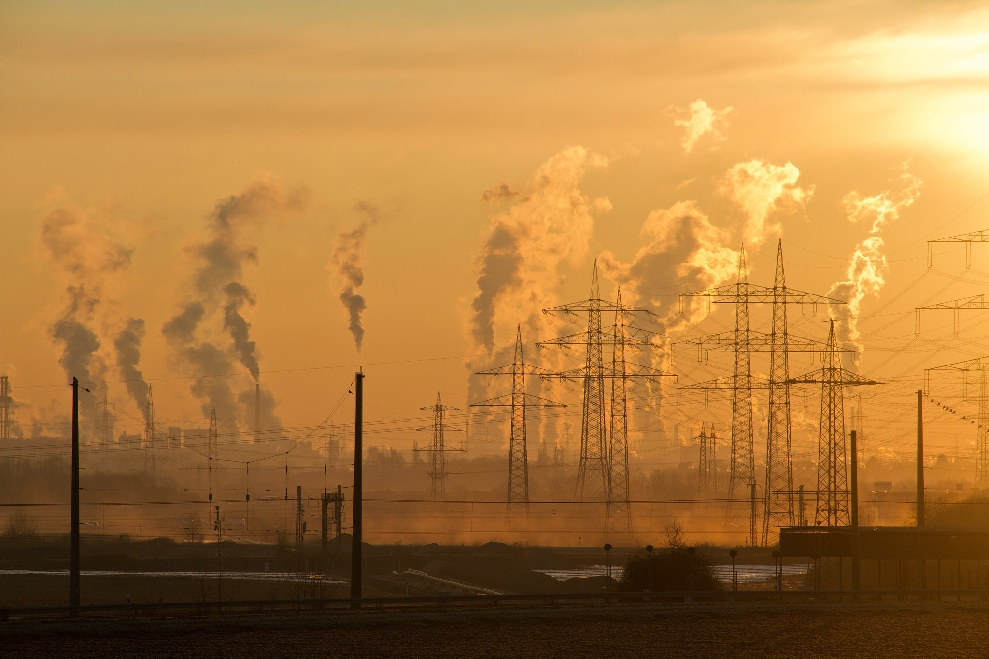
Sustain-Web Website carbon emission estimator
Major Project Final Evaluation
Project by: Project Mentor: Anmol Virdi (19103017) Dr. Jagdeep Kaur Nandini Jaryal (19103070) (Asst. Prof, Computer Science & Engg.)

Slide 2

OUR BIG IDEA
Sustain-Web is a web app that calculates the environmental impact of a web page and displays the breakdown and measures that can be taken to improve it.
Sustain-Web tests 115 best practices from the reference book published by Eyrolles, with contributions by more than 34 business experts. It also considers the underlying subsea cable factors.

Slide 3
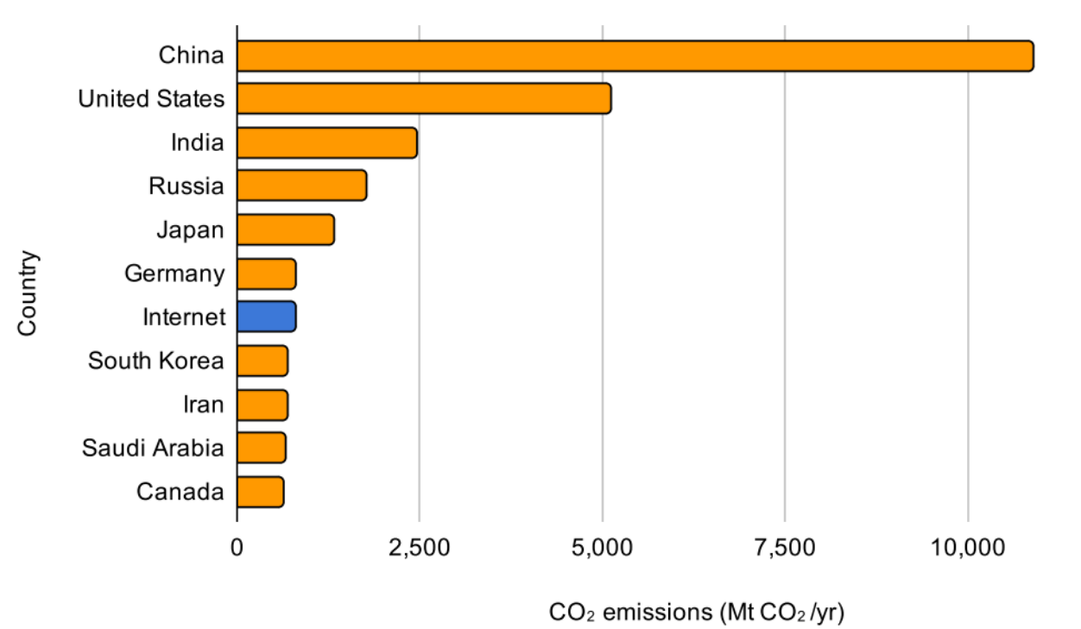
Scenario Today: Web generates 2-4% of CO2 emissions of the planet

Slide 4
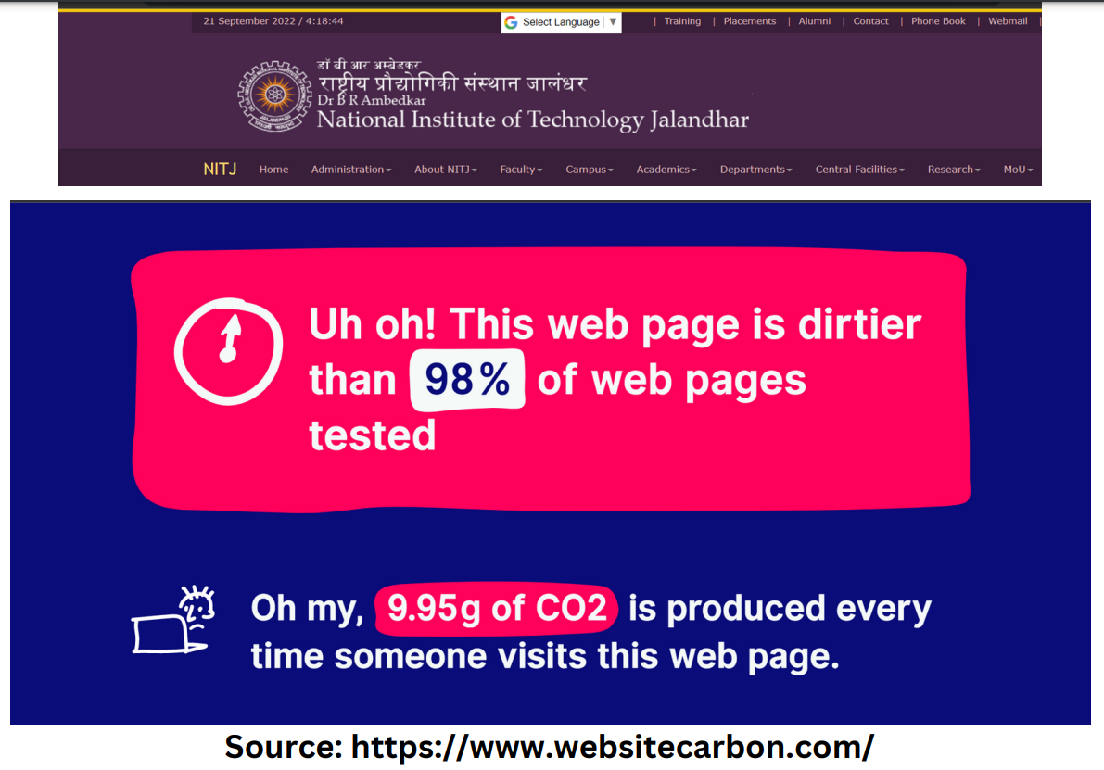

Slide 5
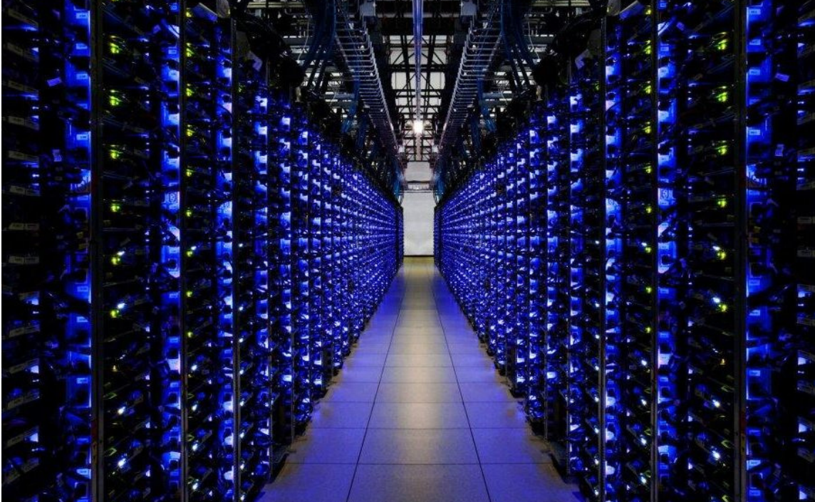


Reasons for C-emission
Data Centers
Underlying Sea Cables
The Page transfer size

Slide 6
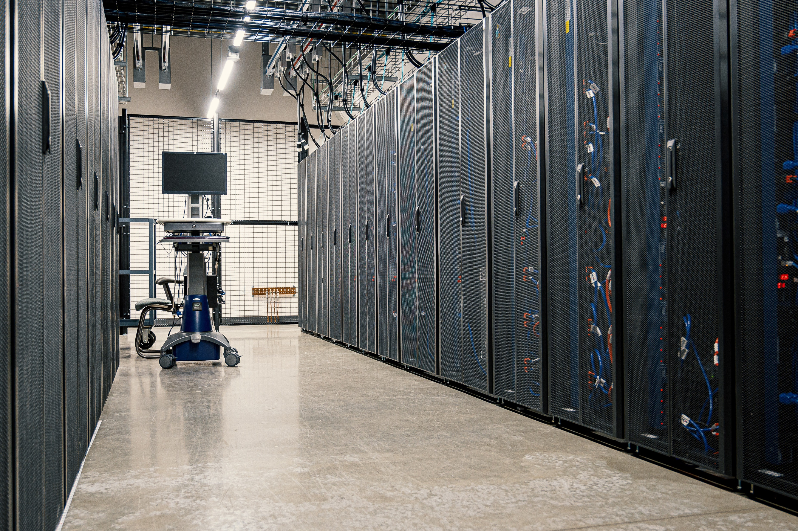
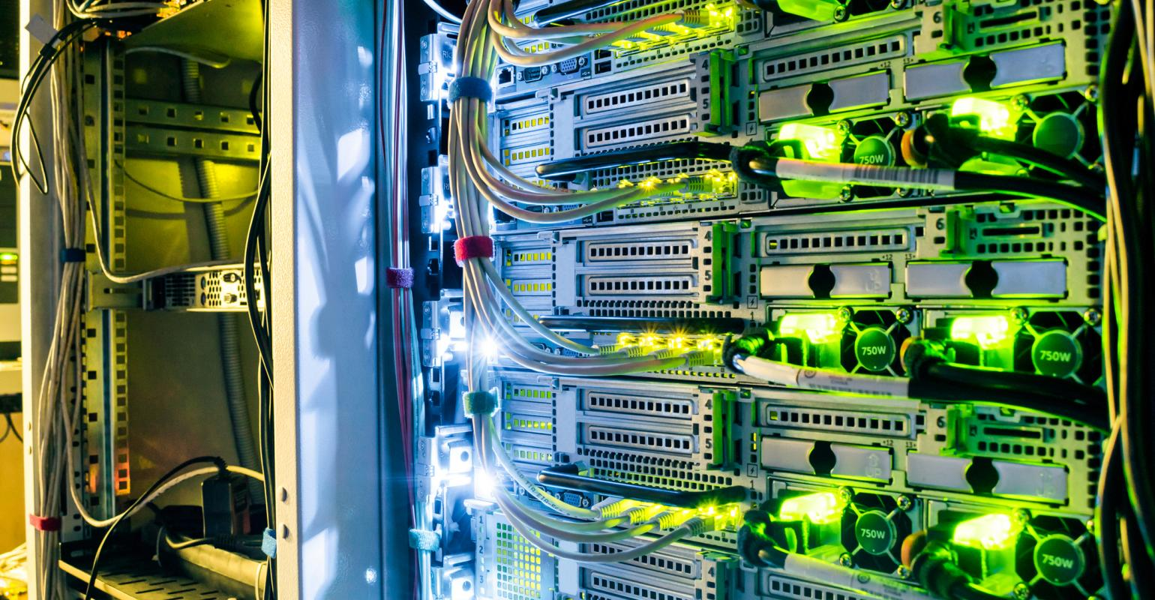
Data Centers
Data centers contribute 2% of the total global greenhouse gas emissions.
As global temperatures rise, the energy required to cool data centers will rise significantly, creating a feedback loop in which climate change increases the energy use and carbon emissions of the internet, which in turn accelerate climate change.

Slide 7

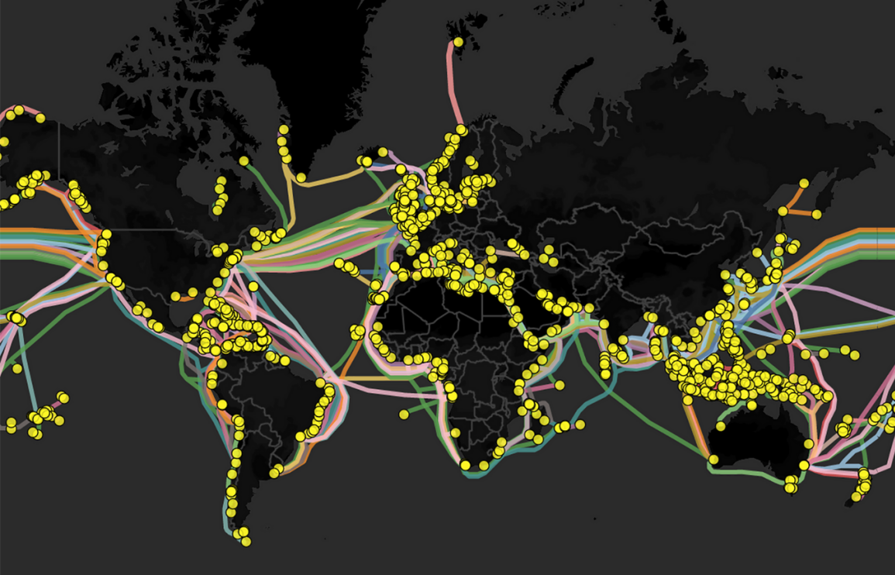
Underlying Sea Cables
Undersea internet cables represent the backbone of the global internet, carrying around 97% of voice and data traffic across the sea floor between land-based stations
72.92 kg CO2eq emitted per kg of optical fiber produced.
Energy is required to transfer information from the data center to the Node/System.

Slide 8
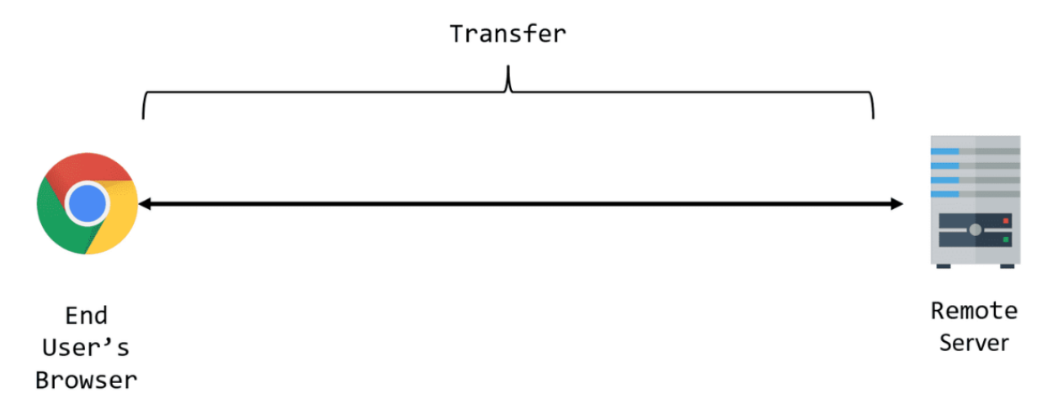
Page Transfer Size
WHAT IS INCLUDED IN THE PAGE SIZE?
Countable factors: Empty tags, Unused image portions, oversized images, repetitive script tags, SSL Certificates, Fonts, etc.
Uncountable factors(Depending on the User session): API calls, Web host, etc.
The Transfer Size of a resource represents the total number of bytes required for transfer across the network.
This is also sometimes referred to as bytes over the wire.
This size considers the transferred payload and any request/response headers.

Slide 9




Tech Stack Used
Main App:
Frontend: HTML, CSS.
Backend: Python Flask
Carbon Calculator:
Python: cssutils, BeautifulSoup.
Selenium UI Testing for finding data center.
Scaling:
Docker, API Integration

Slide 10
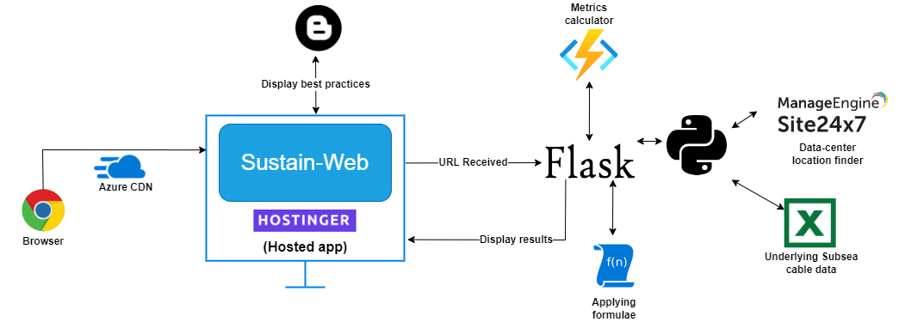
Application Design

Slide 11
Microservice Architecture
Microservices used: 1. SustainWeb API Hosted: Oracle Cloud VM + Docker
Backend: Flask + Selenium Chromedriver
2. SustainWeb Website
Hosted: Oracle Cloud VM + Docker
Backend: Flask
Main Website
Hosted: Netlify
Framework: HTML, CSS

Slide 12
Application Design
Backend components:
Tag estimator (Completed)
Location tracker component (In progress)
Sea cable factor adder (Completed, can be enhanced)
Formulae component (Completed)

Slide 13
Application Design
Frontend Components:
Home page (Completed)
Best practices (In progress)
About us (Completed)
How it works (Not completed yet)
Blogs tab (Awaiting backend integration)

Slide 14
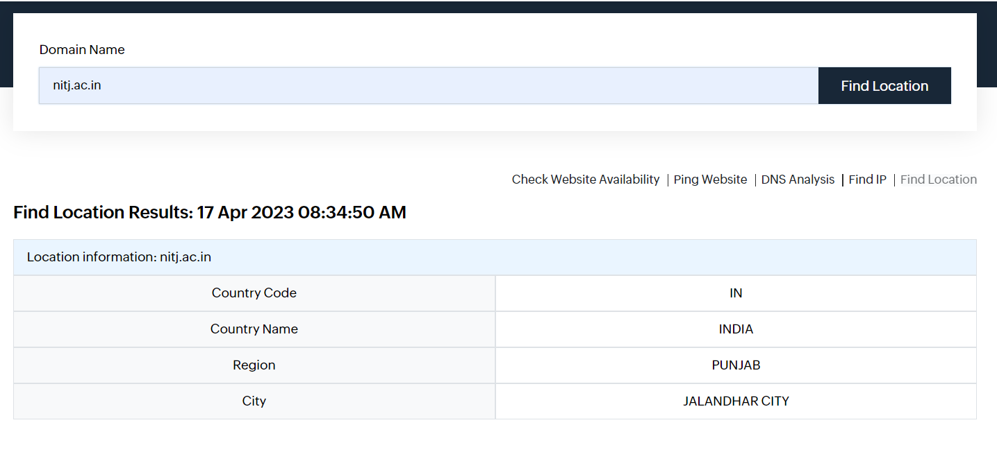
Application Design
Location tracker component

Slide 15
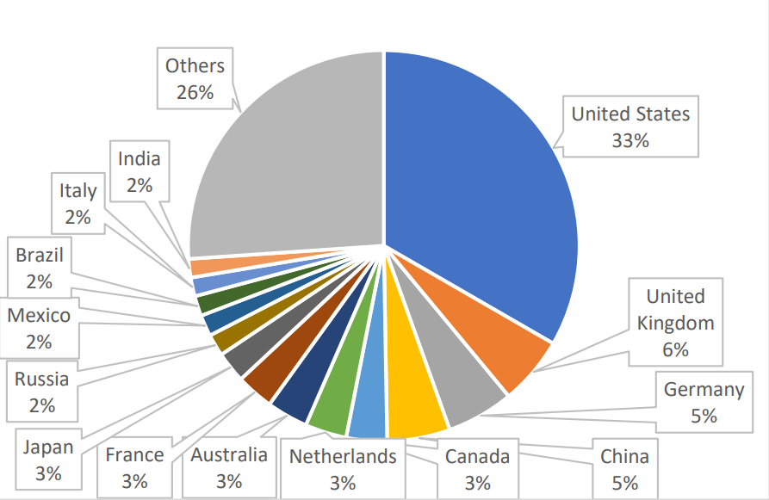
Application Design
Sea cable factor adder
For undersea cable distances, we have used the Submarine Cable Map (https://www.submarinecablemap.com/), which is a public resource that provides information on the routes and landing points of undersea cables around the world.
For carbon intensity factors, we’ve used data from the International Energy Agency (IEA) and other reputable sources, which provide information on the carbon emissions per unit of electricity generated in different countries and regions.

Slide 16

BUSINESS MODEL
Problem Create a platform that can guide developers as well as clients regarding to what extent is their website associated with carbon emissions and propose solutions accordingly. | Solution Sustain-Web is a web app that takes in the URL and considers factors like page transfer size and also the known underlying sea cable data. Then, it estimates the carbon emissions associated with that website and proposes solutions. | Unique Value Proposition Sign-in is not required. It considers the underlying sea cable factor which other similar apps do not. | Unfair Advantage There’s a lot of business potential in the prevention of environmental resources and this app would accelerate the process since it’ll be open-source, people can provide consulting to clients using this app in the background.
Existing Alternative Ecometer Digital Beacon carbonfootprint.com However, no app is considering the underlying sea cable factor as well as factors like non-universal fonts, etc. | Key Metrics Number of people using the application. Total carbon emission calculated | High-Level Concept The purpose of this app is to reduce carbon emissions associated with websites by altering website contents to improve data center life. | Channels Influencer marketing Promotion in competitions and hackathons. Social media marketing. Print media marketing.
Cost Structure Fixed Costs: Cloud platform costs, employees, electricity, internet, marketing, and advertising Variable Costs: Sponsorships, temporary employees, giveaways. | Customer Segments Web Developers Clients who hold websites | Revenue Stream It will have a subscription-based model. Levels of subscription: Premium Users: They can book consultations regarding their website. Free Users: Access to all basic features.

Slide 17
Challenges
Solutions
Location Finder Component
API Integration
Backend integration
Use beautiful soap along with selenium.
Using rapidfort/python-chromedriver container and setting up flask
Using node.js or flask with API Integration

Slide 18
THANK YOU!

